Slide 1



Center Surround Research Update
Ian Cone
Shouval Lab
10/30/20

Slide 2
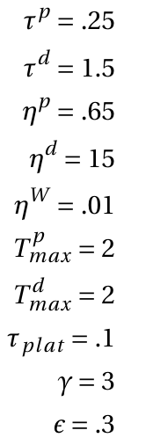
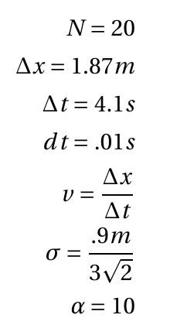
Parameters
Time constant of LTP trace
Number of input neurons
Time constant of LTD trace
Length of track
Activation rate of LTP trace
Time taken to traverse track
Activation rate of LTD trace
Time step
Learning rate
Velocity
Maximum, LTP trace
Maximum, LTD trace
STD of CA3 place fields
Time constant of instructive signal
Weight multiplier
Magnitude of instructive signal
Magnitude of initial weights

Slide 3
Purpose of Hippocampus
Is hippocampus heterogeneously divided into “place” cells, “time” cells, “order” cells?
Or are these subsets of a much larger computational umbrella?

Slide 4
Purpose of Hippocampus
Experiments suggest that characteristic cells in hippocampus (particularly CA3) respond to multiple coincident contexts
ex: “place” cell that only fires in a certain place, while the animal is traveling a certain direction
Another ex: “time” cells which only fire at a particular time, if preceded by presentation a particular odor

Slide 5
Purpose of Hippocampus
What if, like ___ opines, the overarching purpose of hippocampus is to be a general pattern generator, one that takes inputs and creates unique spatiotemporal outputs.

Slide 6
Purpose of Hippocampus
From this framework, there are no “place cells” or “time cells” as such. Instead, a general class of “responsive cells” learns to map behaviorally relevant variables, through some sort of reward or instructive signal

Slide 7
The traditional place field example
Let’s take the traditional example of place field formation in CA1, whereby other place cells or grid cells elsewhere in hippocampus act as input

Slide 8
The General example
What if instead, you had a central pattern generator that would create a unique, robust, history dependent spatiotemporal trajectory for any given combination/sequence of inputs
Inputs can be visual/auditory/olfactory stimuli, place, time, heading, velocity, etc.

Slide 9
The General example: T-Maze
Central pattern generator is given
Inputs can be visual/auditory/olfactory stimuli, place, time, heading, velocity, etc.

Slide 10
The General example: MAGEE + Odor
Preceding an animal’s lap upon a given track, it is puffed/not puffed with a particular odor
An artificial plateau potential is induced at a certain location on the track, for only one of the odors!
The result is a “place + smell” cell, which behaves like a place field, but only on the selected odor track.

Slide 11
The General example: MAGEE + Odor
Preceding an animal’s lap upon a given track, it is puffed/not puffed with a particular odor
An artificial plateau potential is induced at a certain location on the track, for only one of the odors!
The result is a “place + smell” cell, which behaves like a place field, but only on the selected odor track.

Slide 12
How to create Effective CPG
Liquid state machines are often the go to tool for generation of complex and unique spatio-temporal signals for any given input
However, a) their internal states are not robust to noise, and b) the learning rules used (backprop) are biologically unrealistic.

Slide 13
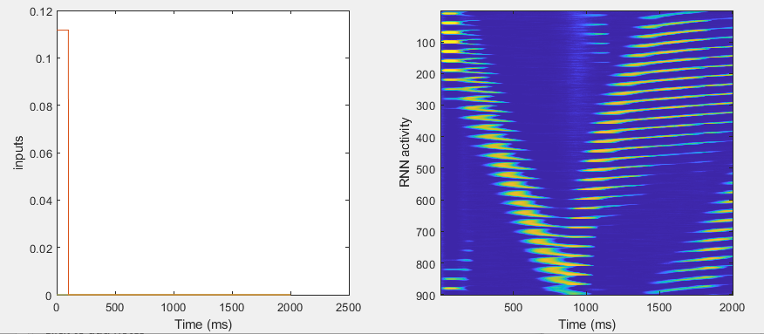
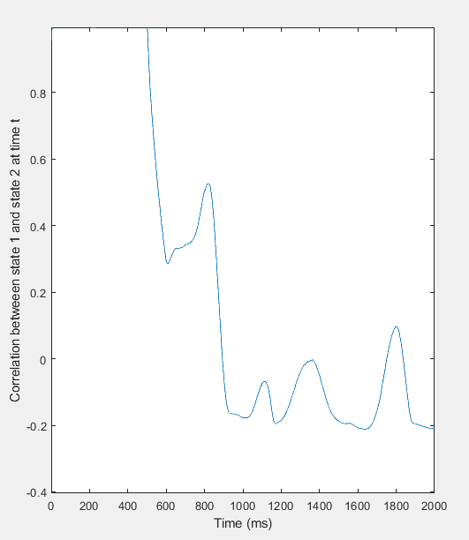
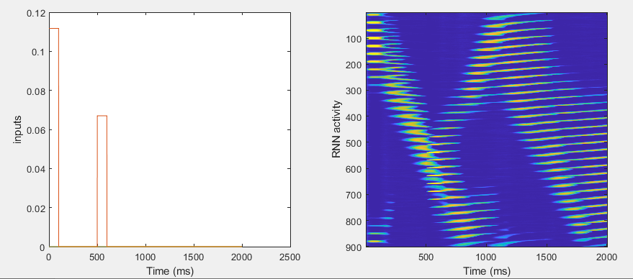
A
A-B

Slide 14
A
A-B

Slide 15
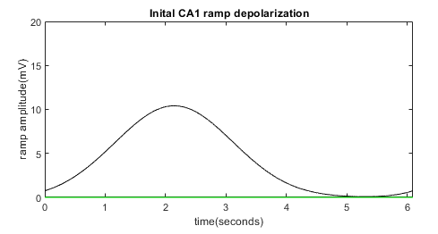

PostSynaptic Voltage

Slide 16
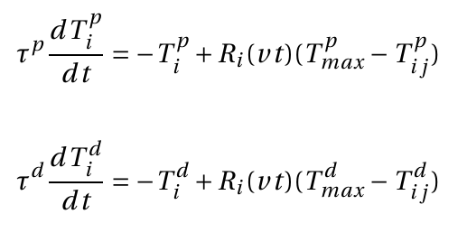
Presynaptic, weight-dependent traces
LTP and LTD associated traces are activated by presynaptic activity and decay in its absence

Slide 17
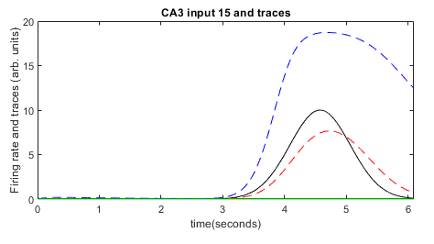
Presynaptic, weight-dependent traces

Slide 18
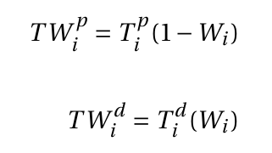

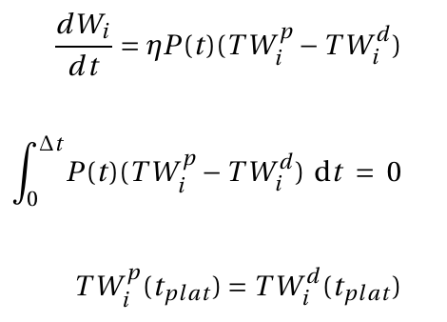
Instructive Signal and Weight updates
Weight modified versions TW favor LTD as weights are large and LTP as weights are small
“Instructive signal” from plateau potential acts as reward
Weights are updated in the presence of the instructive signal as LTP-LTD (both weight modified)

Slide 19
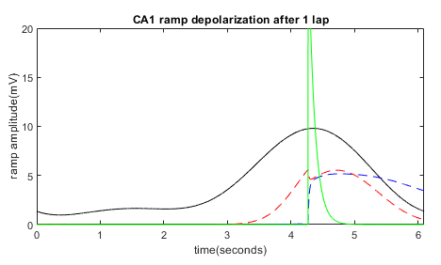
Instructive Signal and Weight updates

Slide 20
Fixed Points
(if P(t) is a delta)

Slide 21
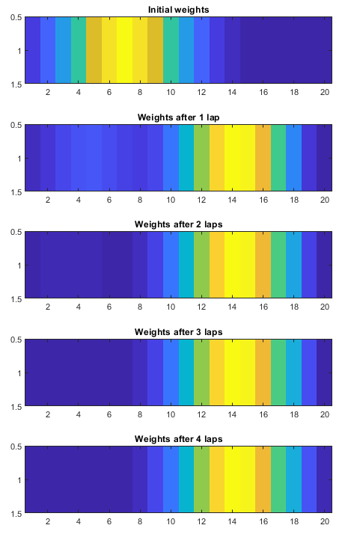
Fixed Points

Slide 22
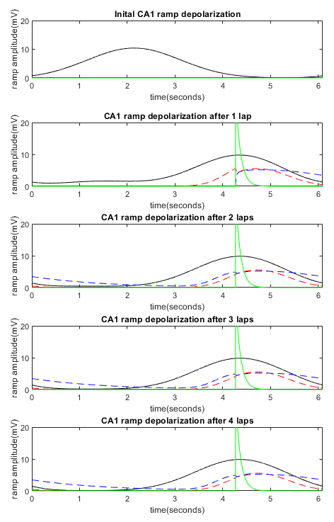
Fixed Points

Slide 23
Fixed Points
Fixed point of each synapse is independent (since no postsynaptic component of learning)
Learning does not change presynaptic firing, so shape of traces does not change (only magnitude)

Slide 24
Fixed Points
CA3 input and traces

Slide 25
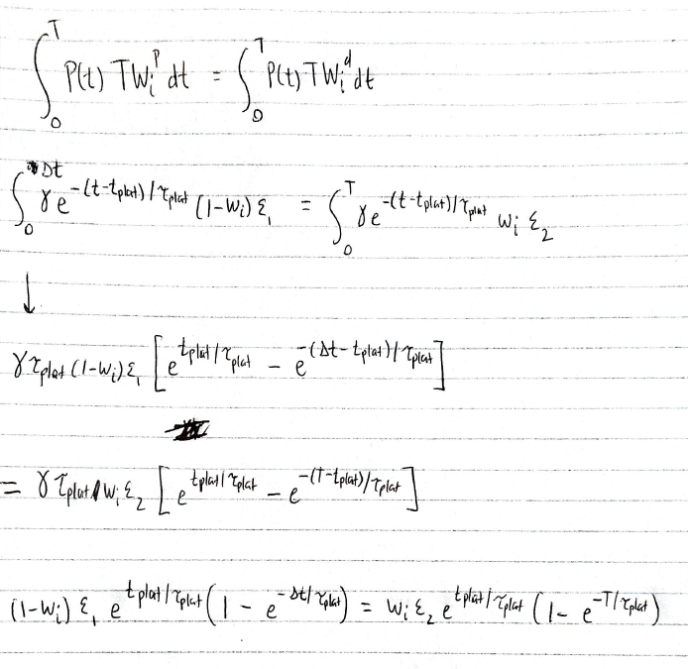
Fixed Points

Slide 26
Fixed Points
CA3 input and traces

